Slide 1


Assembly Language for x86 Processors 7th Edition
Kip R. Irvine
Lecture 7: Integer Arithmetic
(c) Pearson Education, 2015. All rights reserved. You may modify and copy this slide show for your personal use, or for use in the classroom, as long as this copyright statement, the author's name, and the title are not changed.
Last update: 01/06/2020

Slide 2
Lecture Overview
Shift and Rotate Instructions
Shift and Rotate Applications
Multiplication and Division Instructions
Irvine, Kip R. Assembly Language for x86 Processors 7/e, 2015.

Slide 3
Shift and Rotate Instructions
Logical vs Arithmetic Shifts
SHL Instruction
SHR Instruction
SAL and SAR Instructions
ROL Instruction
ROR Instruction
RCL and RCR Instructions
SHLD/SHRD Instructions
Irvine, Kip R. Assembly Language for x86 Processors 7/e, 2015.

Slide 4

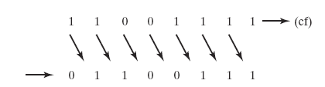
Logical Shift
A logical shift fills the newly created bit position with zero:
Irvine, Kip R. Assembly Language for x86 Processors 7/e, 2015.

Slide 5

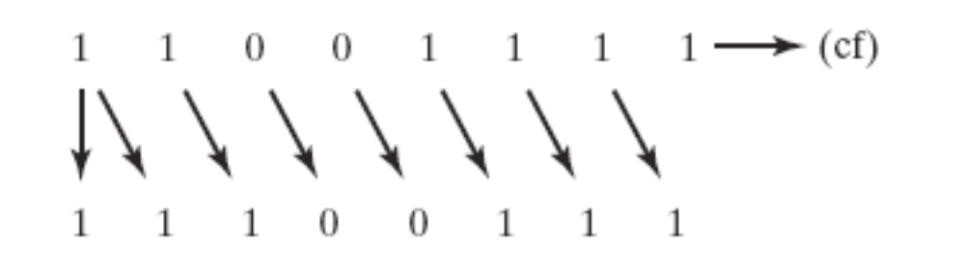
Arithmetic Shift
An arithmetic shift fills the newly created bit position with a copy of the number’s sign bit:
Irvine, Kip R. Assembly Language for x86 Processors 7/e, 2015.

Slide 6
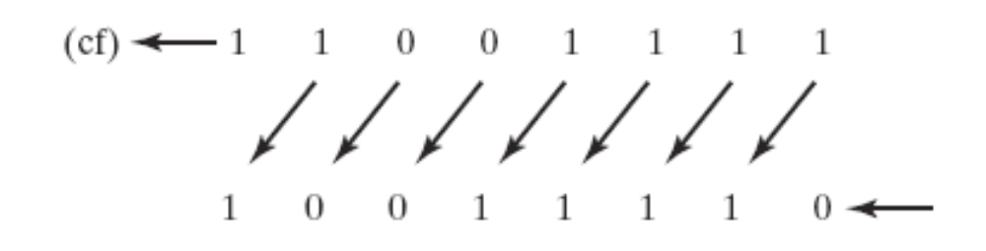
SHL Instruction
The SHL (shift left) instruction performs a logical left shift on the destination operand, filling the lowest bit with 0.
Operand types for SHL:
SHL reg,imm8
SHL mem,imm8
SHL reg,CL
SHL mem,CL
(Same for all shift and rotate instructions)
Irvine, Kip R. Assembly Language for x86 Processors 7/e, 2015.

Slide 7

Fast Multiplication
Shifting left 1 bit multiplies a number by 2
mov dl,5
shl dl,1
Shifting left n bits multiplies the operand by 2^{n}
For example, 5 * 2² = 20
mov dl,5
shl dl,2 ; DL = 20
Irvine, Kip R. Assembly Language for x86 Processors 7/e, 2015.

Slide 8
SHR Instruction
The SHR (shift right) instruction performs a logical right shift on the destination operand. The highest bit position is filled with a zero.
Shifting right n bits divides the operand by 2^{n}
mov dl,80
shr dl,1 ; DL = 40
shr dl,2 ; DL = 10
Irvine, Kip R. Assembly Language for x86 Processors 7/e, 2015.

Slide 9
SAL and SAR Instructions
SAL (shift arithmetic left) is identical to SHL.
SAR (shift arithmetic right) performs a right arithmetic shift on the destination operand.
An arithmetic shift preserves the number's sign.
mov dl,-80
sar dl,1 ; DL = -40
sar dl,2 ; DL = -10
Irvine, Kip R. Assembly Language for x86 Processors 7/e, 2015.

Slide 10

ROL Instruction
ROL (rotate) shifts each bit to the left
The highest bit is copied into both the Carry flag and into the lowest bit
No bits are lost
mov al,11110000b
rol al,1 ; AL = 11100001b
mov dl,3Fh
rol dl,4 ; DL = F3h
Irvine, Kip R. Assembly Language for x86 Processors 7/e, 2015.

Slide 11

ROR Instruction
ROR (rotate right) shifts each bit to the right
The lowest bit is copied into both the Carry flag and into the highest bit
No bits are lost
mov al,11110000b
ror al,1 ; AL = 01111000b
mov dl,3Fh
ror dl,4 ; DL = F3h
Irvine, Kip R. Assembly Language for x86 Processors 7/e, 2015.

Slide 12
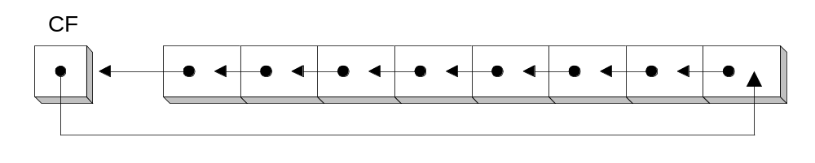
RCL Instruction
RCL (rotate carry left) shifts each bit to the left
Copies the Carry flag to the least significant bit
Copies the most significant bit to the Carry flag
clc ; CF = 0
mov bl,88h ; CF,BL = 0 10001000b
rcl bl,1 ; CF,BL = 1 00010000b
rcl bl,1 ; CF,BL = 0 00100001b
Irvine, Kip R. Assembly Language for x86 Processors 7/e, 2015.

Slide 13
RCR Instruction
RCR (rotate carry right) shifts each bit to the right
Copies the Carry flag to the most significant bit
Copies the least significant bit to the Carry flag
stc ; CF = 1
mov ah,10h ; CF,AH = 1 00010000b
rcr ah,1 ; CF,AH = 0 10001000b
Irvine, Kip R. Assembly Language for x86 Processors 7/e, 2015.

Slide 14
SHLD Instruction
Shifts a destination operand a given number of bits to the left
The bit positions opened up by the shift are filled by the most significant bits of the source operand
The source operand is not affected
Syntax:
  SHLD destination, source, count
Operand types:
SHLD reg16/32, reg16/32, imm8/CL
SHLD mem16/32, reg16/32, imm8/CL
Irvine, Kip R. Assembly Language for x86 Processors 7/e, 2015.

Slide 15
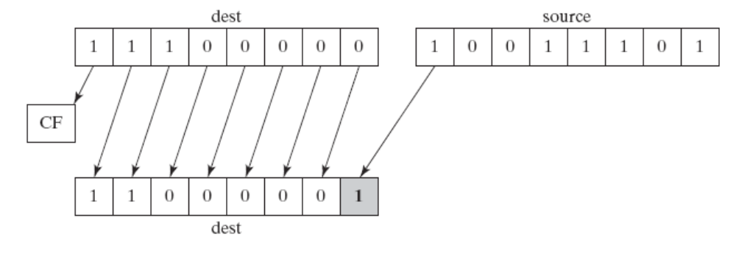
SHLD Example
Shift count of 1:
mov al,11100000b
mov bl,10011101b
shld al,bl,1
Irvine, Kip R. Assembly Language for x86 Processors 7/e, 2015.

Slide 16
SHRD Instruction
Shifts a destination operand a given number of bits to the right
The bit positions opened up by the shift are filled by the least significant bits of the source operand
The source operand is not affected
Syntax:
  SHRD destination, source, count
Operand types:
SHRD reg16/32, reg16/32, imm8/CL
SHRD mem16/32, reg16/32, imm8/CL
Irvine, Kip R. Assembly Language for x86 Processors 7/e, 2015.

Slide 17
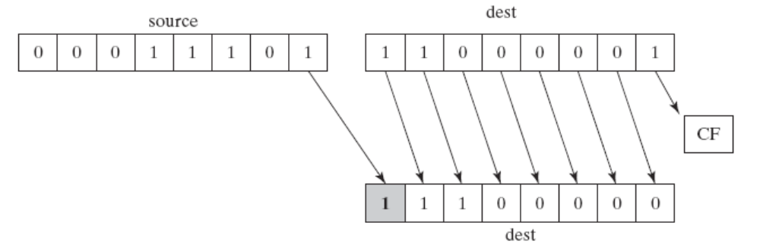
SHRD Example
Shift count of 1:
mov al,11000001b
mov bl,00011101b
shrd al,bl,1
Irvine, Kip R. Assembly Language for x86 Processors 7/e, 2015.

Slide 18
What's Next
Shift and Rotate Instructions
Shift and Rotate Applications
Multiplication and Division Instructions
Irvine, Kip R. Assembly Language for x86 Processors 7/e, 2015.

Slide 19
Shift and Rotate Applications
Binary Multiplication
Isolating a Bit String
Irvine, Kip R. Assembly Language for x86 Processors 7/e, 2015.

Slide 20
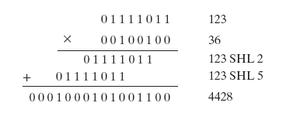
Binary Multiplication
mutiply 123 * 36
Irvine, Kip R. Assembly Language for x86 Processors 7/e, 2015.

Slide 21
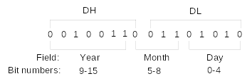
Isolating a Bit String
The MS-DOS file date field packs the year, month, and day into 16 bits:
Isolate the Month field:
mov ax,dx ; make a copy of DX
shr ax,5 ; shift right 5 bits
and al,00001111b ; clear bits 4-7
mov month,al ; save in month variable
Irvine, Kip R. Assembly Language for x86 Processors 7/e, 2015.

Slide 22
What's Next
Shift and Rotate Instructions
Shift and Rotate Applications
Multiplication and Division Instructions
Irvine, Kip R. Assembly Language for x86 Processors 7/e, 2015.

Slide 23
Multiplication and Division Instructions
MUL Instruction
IMUL Instruction
DIV Instruction
Signed Integer Division
CBW, CWD, CDQ Instructions
IDIV Instruction
Irvine, Kip R. Assembly Language for x86 Processors 7/e, 2015.

Slide 24
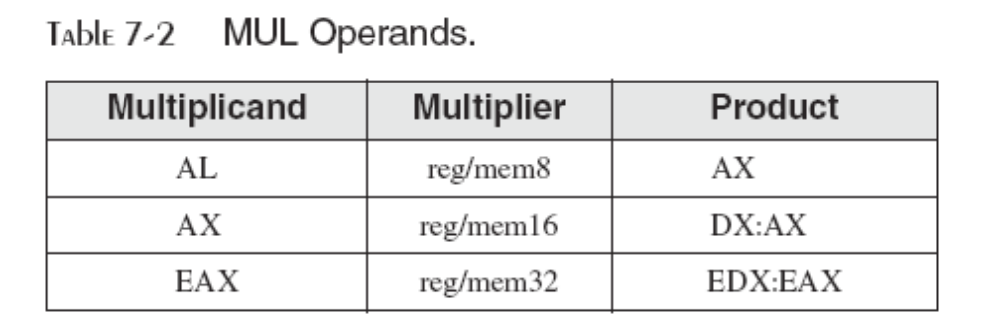
MUL Instruction
In 32-bit mode, MUL (unsigned multiply) instruction multiplies an 8-, 16-, or 32-bit operand by either AL, AX, or EAX.
The instruction formats are:
    MUL r/m8
    MUL r/m16
    MUL r/m32
Irvine, Kip R. Assembly Language for x86 Processors 7/e, 2015.

Slide 25
MUL Examples
100h * 2000h, using 16-bit operands:
.data
val1 WORD 2000h
val2 WORD 100h
.code
mov ax,val1
mul val2 ; DX:AX = 00200000h, CF=1
The Carry flag indicates whether or not the upper half of the product contains significant digits.
12345h * 1000h, using 32-bit operands:
mov eax,12345h
mov ebx,1000h
mul ebx ; EDX:EAX = 0000000012345000h, CF=0
Irvine, Kip R. Assembly Language for x86 Processors 7/e, 2015.

Slide 26
IMUL Instruction
IMUL (signed integer multiply ) multiplies an 8-, 16-, or 32-bit signed operand by either AL, AX, or EAX
Preserves the sign of the product by sign-extending it into the upper half of the destination register
Example: multiply 48 * 4, using 8-bit operands:
mov al,48
mov bl,4
imul bl ; AX = 00C0h, OF=1
OF=1 because AH is not a sign extension of AL.
Irvine, Kip R. Assembly Language for x86 Processors 7/e, 2015.

Slide 27
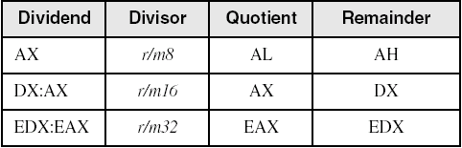
DIV Instruction
The DIV (unsigned divide) instruction performs 8-bit, 16-bit, and 32-bit division on unsigned integers
A single operand is supplied (register or memory operand), which is assumed to be the divisor
Instruction formats:
    DIV reg/mem8
    DIV reg/mem16
    DIV reg/mem32
Default Operands:
Irvine, Kip R. Assembly Language for x86 Processors 7/e, 2015.

Slide 28
DIV Examples
Divide 8003h by 100h, using 16-bit operands:
mov dx,0 ; clear dividend, high
mov ax,8003h ; dividend, low
mov cx,100h ; divisor
div cx ; AX = 0080h, DX = 3
Same division, using 32-bit operands:
mov edx,0 ; clear dividend, high
mov eax,8003h ; dividend, low
mov ecx,100h ; divisor
div ecx ; EAX = 00000080h, DX = 3
Irvine, Kip R. Assembly Language for x86 Processors 7/e, 2015.

Slide 29
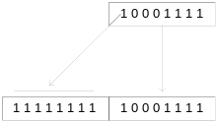
Signed Integer Division (IDIV)
Signed integers must be sign-extended before division takes place
  fill high byte/word/doubleword with a copy of the low byte/word/doubleword's sign bit
For example, the high byte contains a copy of the sign bit from the low byte:
Irvine, Kip R. Assembly Language for x86 Processors 7/e, 2015.

Slide 30
CBW, CWD, CDQ Instructions
The CBW, CWD, and CDQ instructions provide important sign-extension operations:
  CBW (convert byte to word) extends AL into AH
  CWD (convert word to doubleword) extends AX into DX
  CDQ (convert doubleword to quadword) extends EAX into EDX
Example:
    .data
    dwordVal SDWORD -101 ; FFFFFF9Bh
    .code
    mov eax,dwordVal
    cdq ; EDX:EAX = FFFFFFFFFFFFFF9Bh
Irvine, Kip R. Assembly Language for x86 Processors 7/e, 2015.

Slide 31
IDIV Instruction
IDIV (signed divide) performs signed integer division
Same syntax and operands as DIV instruction
Example: 8-bit division of –48 by 5
mov al,-48
cbw ; extend AL into AH
mov bl,5
idiv bl ; AL = -9, AH = -3
Irvine, Kip R. Assembly Language for x86 Processors 7/e, 2015.

Slide 32
IDIV Examples
Example: 16-bit division of –48 by 5
mov ax,-48
cwd ; extend AX into DX
mov bx,5
idiv bx ; AX = -9, DX = -3
Example: 32-bit division of –48 by 5
mov eax,-48
cdq ; extend EAX into EDX
mov ebx,5
idiv ebx ; EAX = -9, EDX = -3
Irvine, Kip R. Assembly Language for x86 Processors 7/e, 2015.

Slide 33
Summary
Shift and rotate instructions are some of the best tools of assembly language
  finer control than in high-level languages
  SHL, SHR, SAR, ROL, ROR, RCL, RCR
MUL and DIV – integer operations
  close relatives of SHL and SHR
  CBW, CDQ, CWD: preparation for division
Irvine, Kip R. Assembly Language for x86 Processors 7/e, 2015.

Slide 34

55 74 67 61 6E 67 65 6E
Irvine, Kip R. Assembly Language for x86 Processors 7/e, 2015.

